Slide 2
WELCOME
Roy Jones, CEO
Notes:
Welcome

Slide 3
Key Findings: Retail Customer Survey
Notes:
Key Findings: Retail Customer Survey
Our most recent Retail Customer Survey shows that when we compare our public power to the IOUs and co-ops…
We have fewer Status Quo and Technology Cautious customers, instead:
We have more Savings Seekers and Green Champions than our competitors
What that means…
Our customers are looking to us to find the right technologies to enhance their experience to help them lower their bills in an environmentally friendly and low-cost way

Slide 4
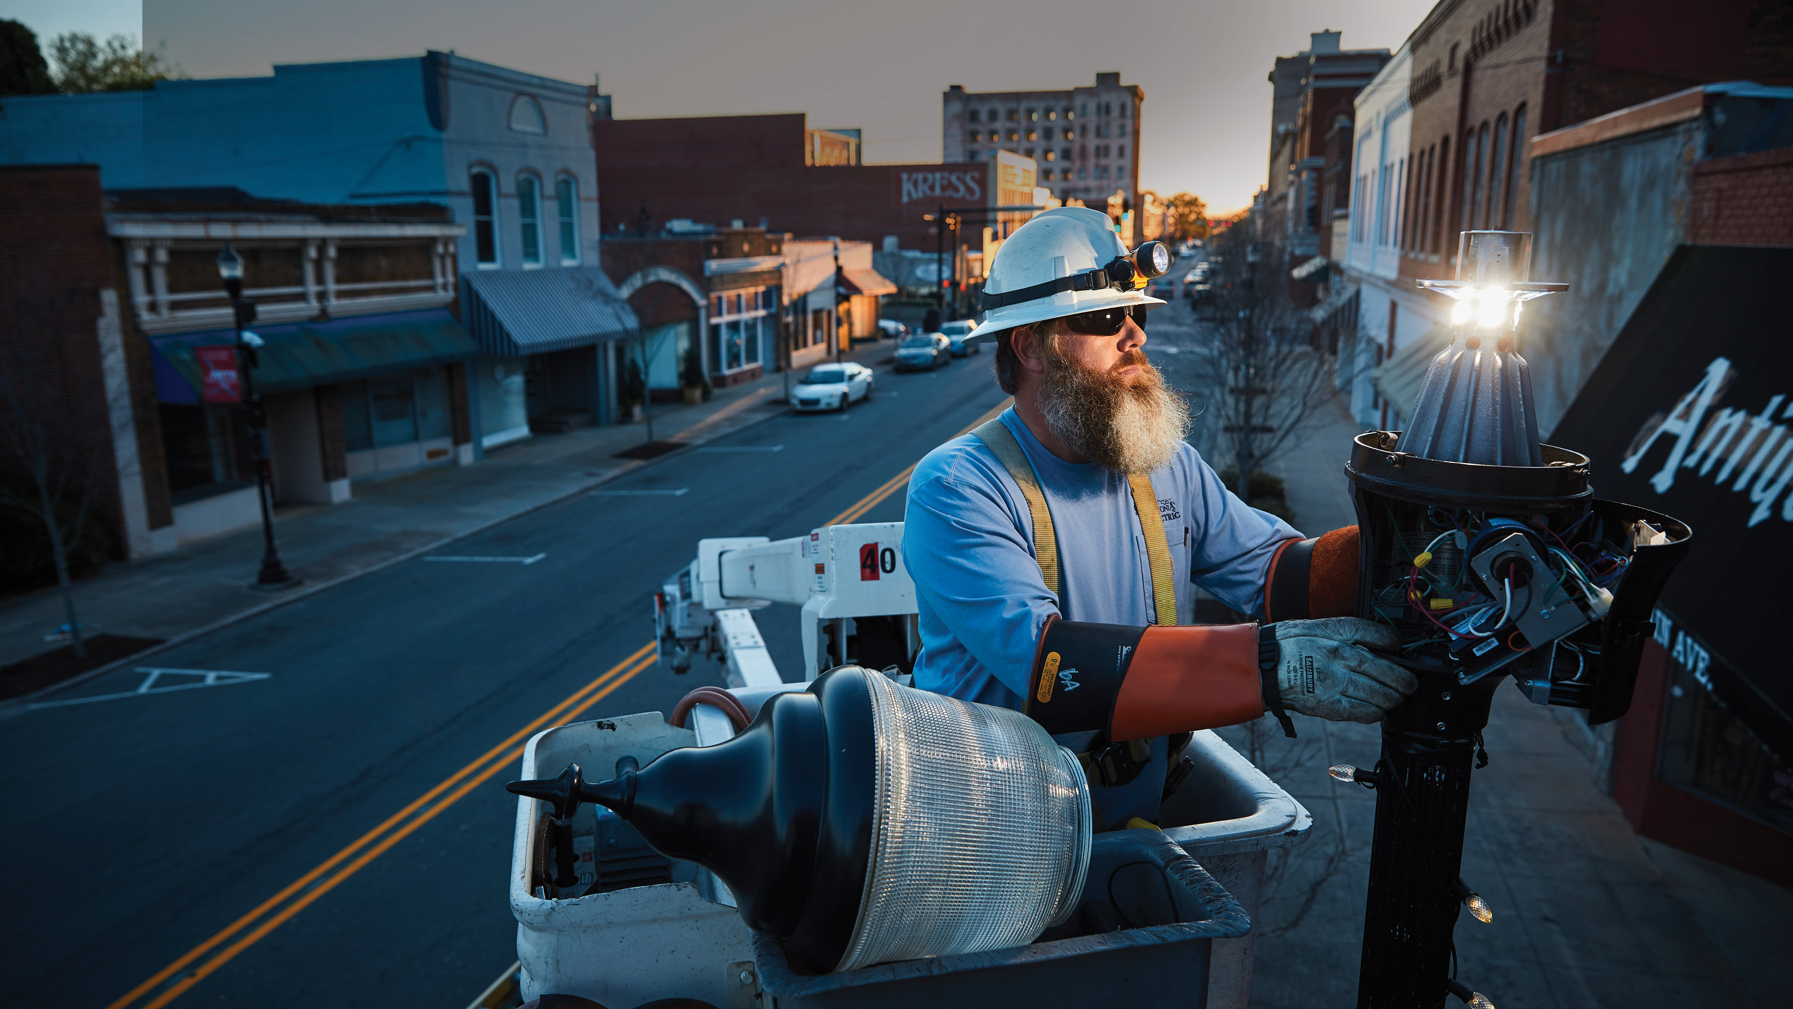
Let’s Talk About Innovation
Notes:
Let’s Talk About Innovation
Everyone loves innovation... Our customers are no different
But let’s face it, innovation isn’t our thing
Most of us are engineers. And we’ve been focused on one important job ⎯ keeping the lights on ⎯ and doing it safely and affordably
We do a really good job at that, and that is still job one
But it’s not enough… Our customers expect more from us

Slide 5
Customers Expect More From Us
Notes:
Customers Expect More From Us
We’ve talked a lot over the past few years about how we’ve become an “on demand” society thanks to companies like Amazon that will deliver whatever you want at a moment’s notice
And that impacts what customers think about all service providers… including utilities
They expect text messages that provide instant updates on power outages…
They want to pay their electric bill by talking to Alexa, or using Venmo
They want to see us innovate just like other industries.

Slide 6
Innovative Technologies
Notes:
Innovative Technologies
Consider the world our customers live in…
They see the visionary new technologies that are introduced each year at the Consumer Electronics Show in Las Vegas
They see concepts for flying taxis, hear about the latest advances in the Internet of Things, and are exposed to all sorts of innovations
We shouldn’t expect to see flying taxis anytime soon, but many of these innovations will impact us sooner rather than later

Slide 7
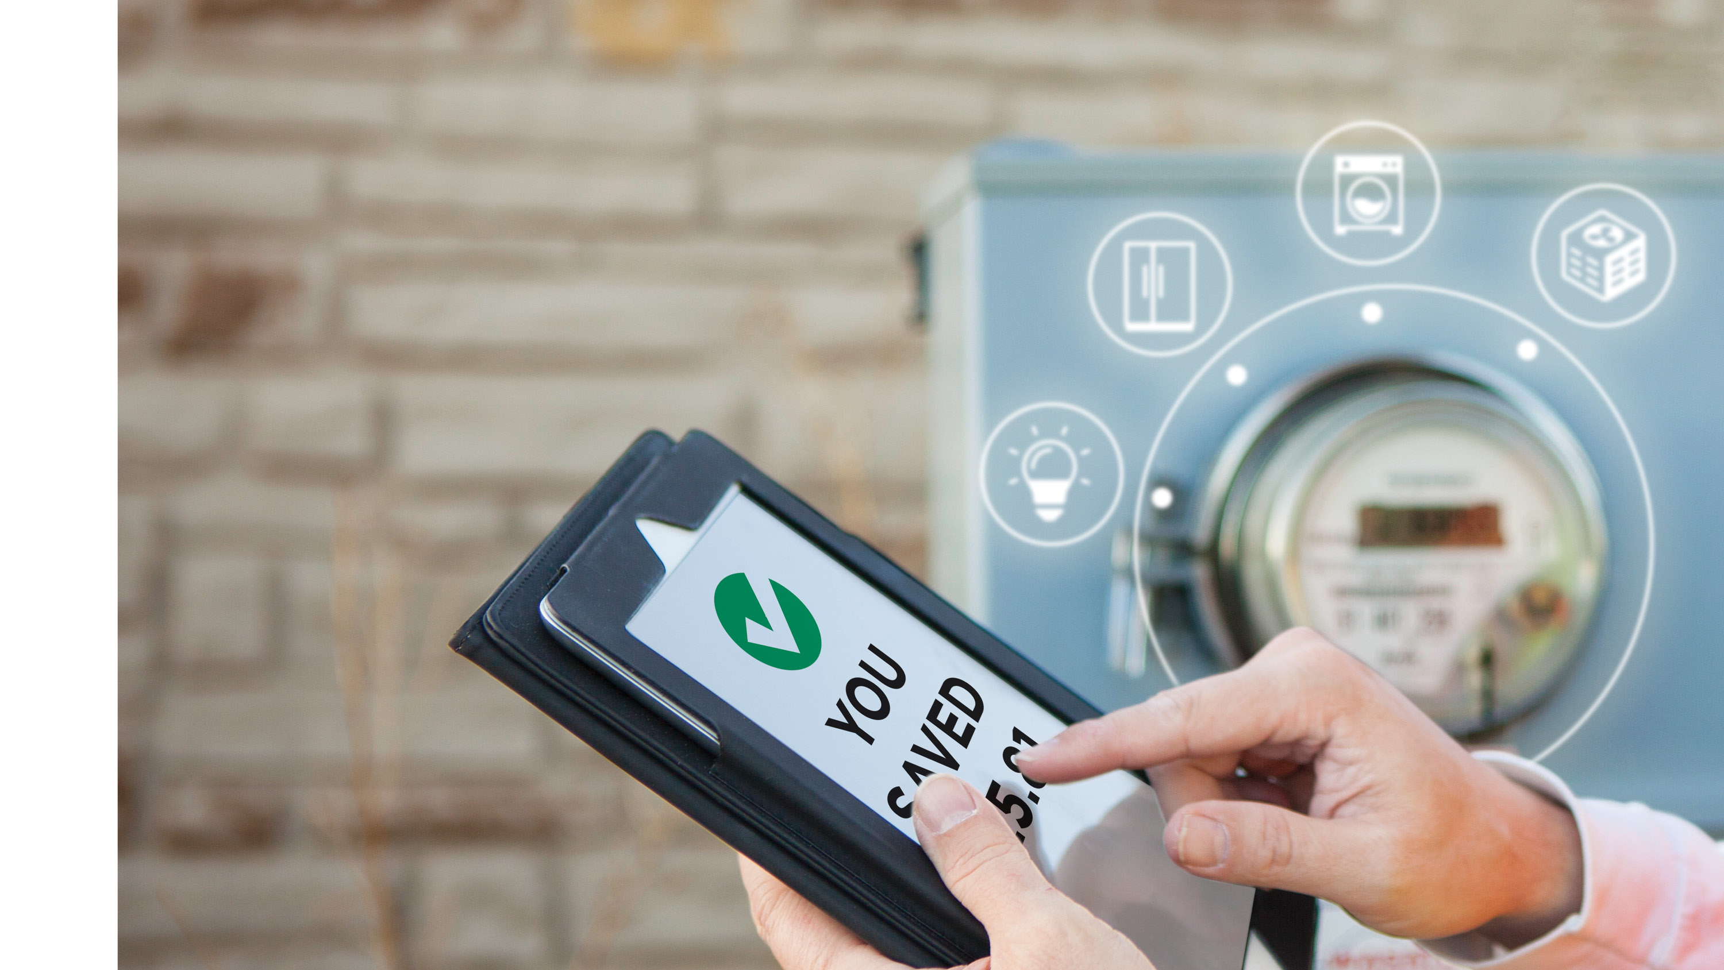
Technologies We Should Be Monitoring
Notes:
Technologies We Should Be Monitoring
There are three types of technologies we need to focus us:
Smart Meters
Home Automation Devices, and
Smart Cities Technologies
And we need to think like innovators about how we can leverage these technologies for our communities

Slide 8
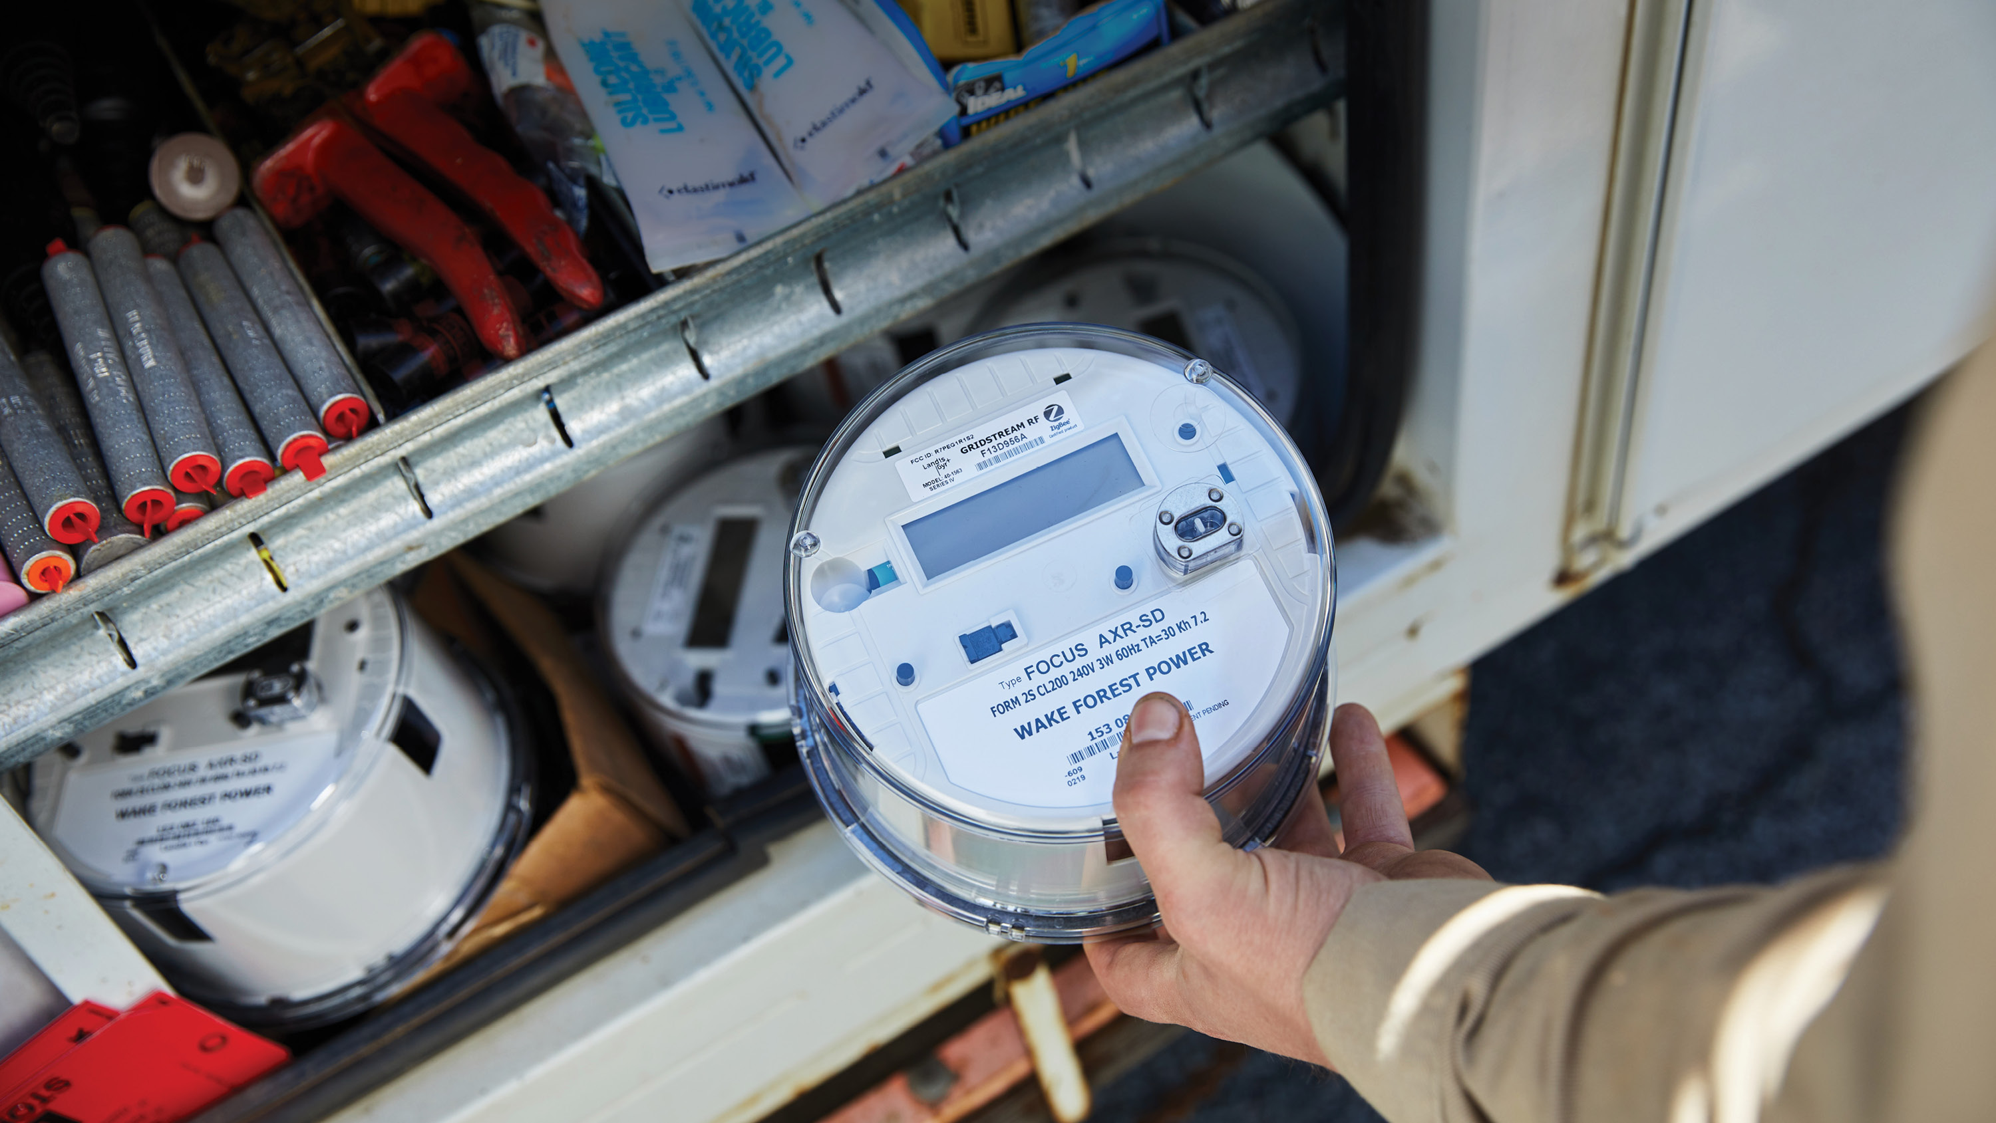
Smart Meters
Notes:
Smart Meters
Many communities have already installed smart meters and others are doing so right now
This technology is important because it represents our way of communicating energy usage to our customers.
The internet is also allowing us to tap into the power of home automation devices.

Slide 9
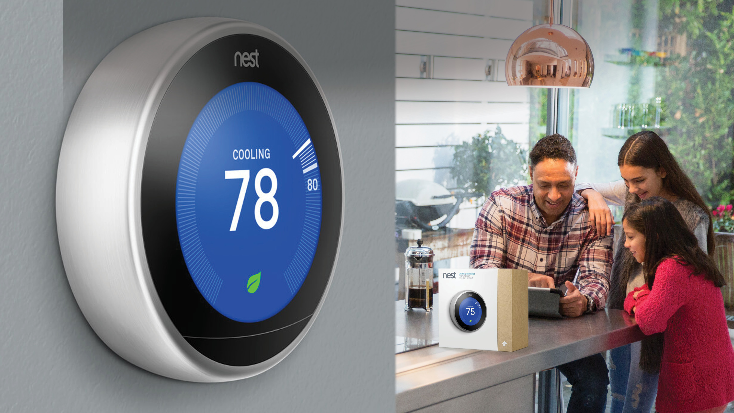
Home Automation and Energy Savings
Notes:
Home Automation and Energy Savings
This is where real advances are being made…
Our homes are becoming smarter every day
Ring doorbells alert us when someone shows up at the door
Nest thermostats detect when someone enters a room and adjust the temperature
Roomba vacuums clean up while we’re gone
Three reasons:
They have a cool “gadget” factor
They can make our life easier, and
They can reduce our energy usage
These devices are becoming more and more integrated
Apple, Google, and Amazon are developing standards that will allow these devices to work across platforms

Slide 10
Smart Cities
Notes:
Smart Cities
This is another topic we’ve talked about before…
Very specialized services… Trash cans that automatically alert you when they are full
And technologies with much broader applications:
Traffic lights that can detect gunshots and alert police
Chips inside our roads and inside our cars that can provide a constant flow of data about traffic patterns and congestion

Slide 11
My Challenge To You
Notes:
My Challenge To You
Spend the next three days thinking like an innovator
Set aside for a moment whatever challenge you are dealing with back in your community
Think about the future and imagine what is possible

Slide 12
The Public Power Advantage
Notes:
The Public Power Advantage
Because we are public power communities:
We have more control over our future
We can make decisions faster
Example: Rate structures that serve as a signal about how we want to influence customer behavior (ex: time of use)
_______________________________________________________________________
We have strong relationships with our customers.
Customer surveys show us that our customers trust us

Slide 13
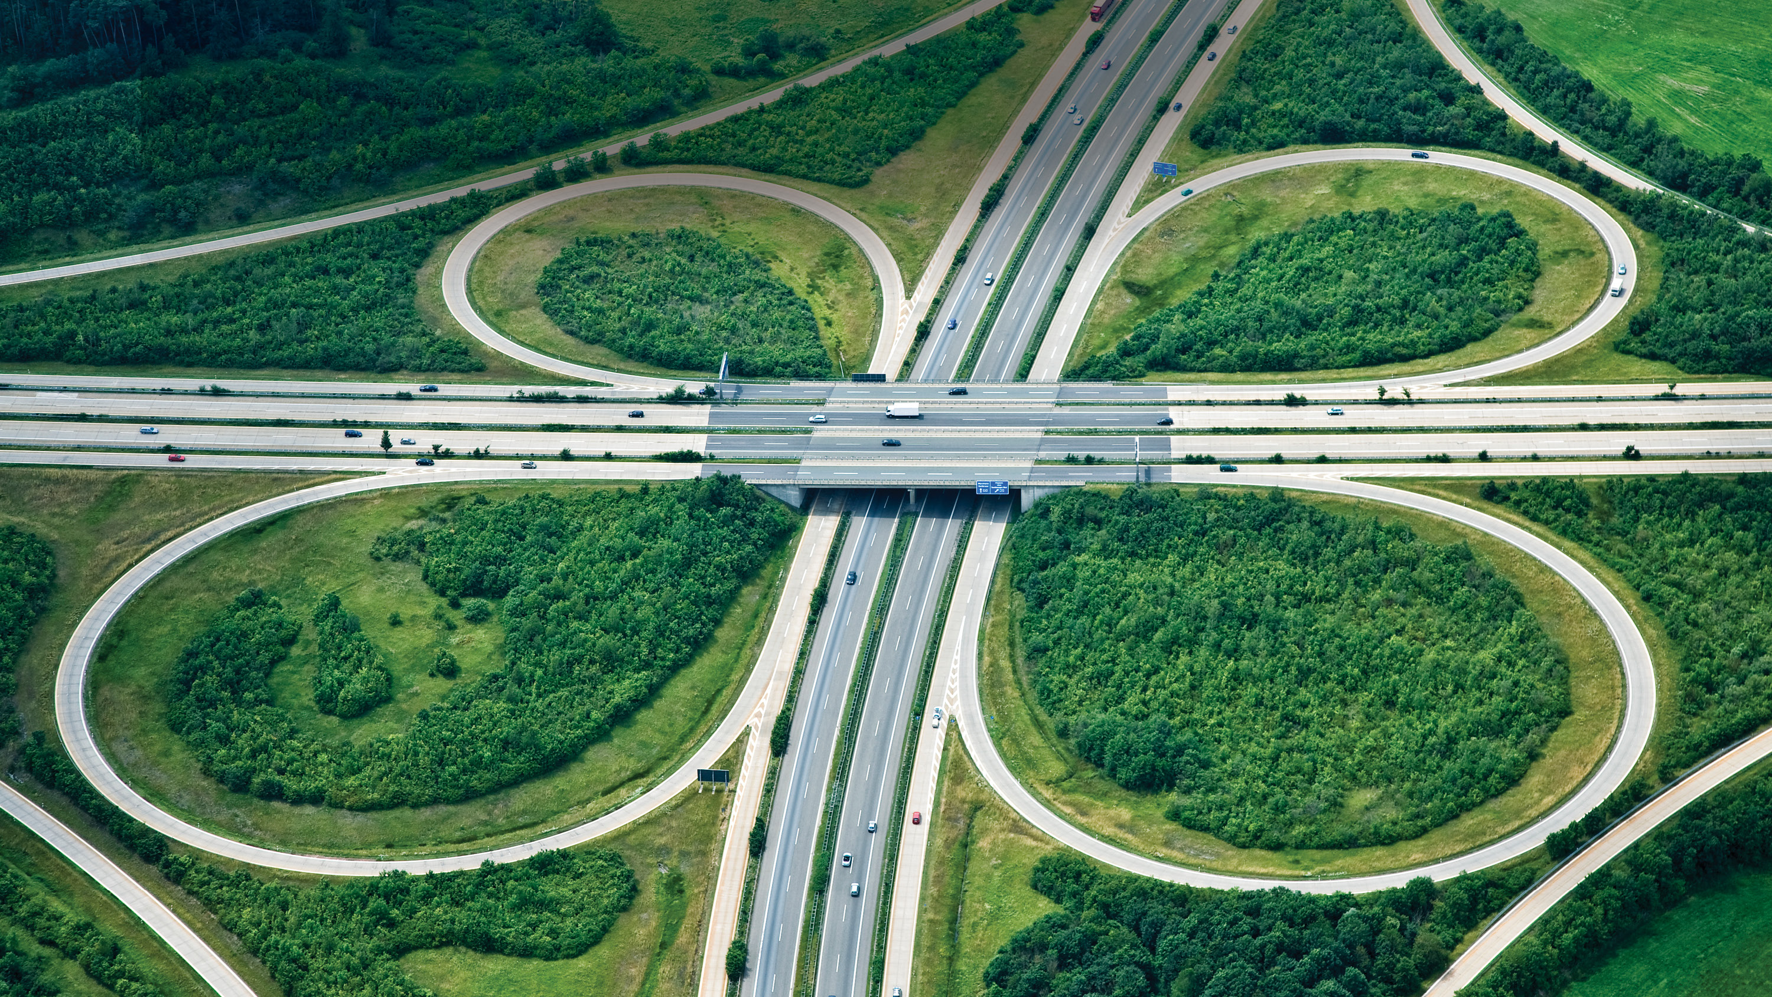
Where Do We Go From Here?
Notes:
Where do we go from here?
Talking about innovation and new technologies can be overwhelming
The key is determining what is right for your community
It begins with understanding customer needs and putting an appropriate technology infrastructure in place
Consider how your customer needs fit into your town’s plans…
Look at our individual communities and decide the best path forward

Slide 14
What You Will Learn This Week
Notes:
What You Will Learn This Week
This week we will provide you with plenty of knowledge and resources…
We’ll touch on a lot of topics about how to effectively use new technologies
Cybersecurity
Building a workforce for the future
_________________________________________________________________
Challenge us all to think outside the box…
Open your mind and think about how your can bring innovation to your communities

Slide 15
Notes:
Thank You

